Slide 1
QUANTIZATION
Performs Discretization in amplitude.
Sampling results in a series of pulses of varying amplitude values ranging between two limits: a min and a max.
The amplitude values are infinite between the two limits.
We need to map the infinite amplitude values onto a finite set of known values.
This is achieved by dividing the distance between min and max into L zones, each of step size Δ.
Δ = (V_{max} - V_{min})/ L

Slide 2
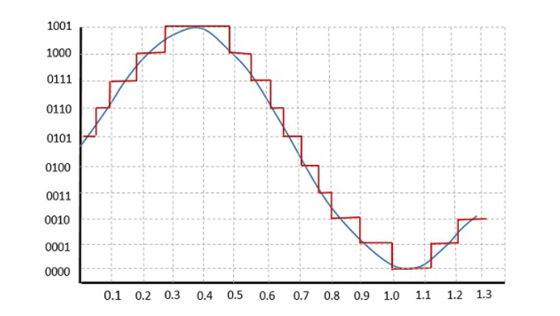
The following figure shows how an analog signal gets quantized. The blue line represents analog signal while the brown one represents the quantized signal. Quantized s/g also called as Stair-case waveform, in accordance with its shape.

Slide 3
Steps in quantization
No. of Quantization levels L=2^{n} ; quantizer use n no. of binary digits to represent each level.
Total voltage range is divided into L equal intervals of step size (quantum) Δ
Δ = (V_{max} - V_{min})/L
= (V_{max} - V_{min})/ 2^{n}
Draw mid lines representing quantization levels
Assign binary codes (pre-defined) to each quantization level
Calculate quantization error

Slide 4
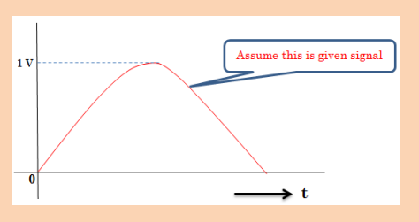
Quantization Example
Q. A 2-bit PCM modulator is used with a 0-1 V signal. What is the binary digital value that will occur for the following inputs: 0.4 V, 0.78 V. What is the quantization error for these two samples?
n = number of bits = 2
L = No. of quantization levels = 2^{n} = 4

Slide 5
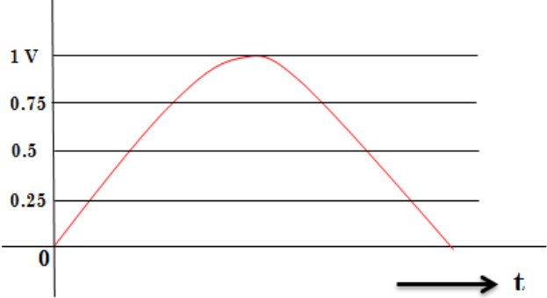
STEPS IN QUANTIZATION
Total voltage range is divided into L equal intervals of step size Δ
Δ= (1−0)/2² =1/4 =0.25

Slide 6
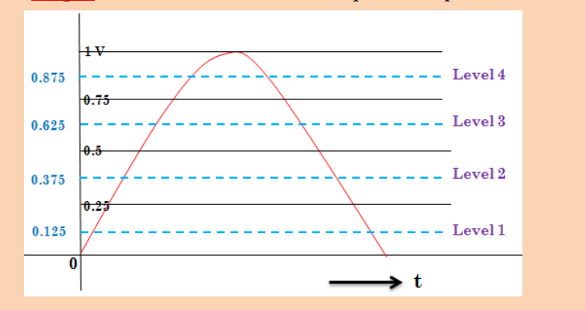
2. Draw mid-lines, which represents quantization levels.

Slide 7
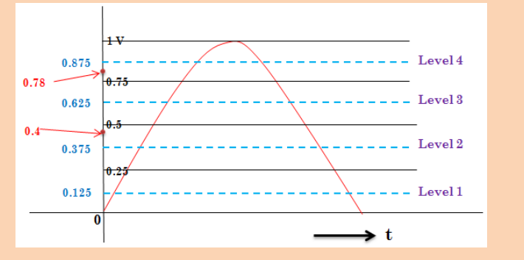
3. Denote given sample values i.e., 0.4 V & 0.78 V

Slide 8
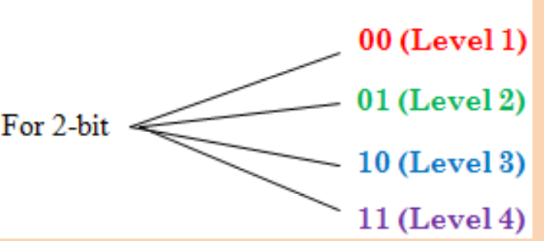
4. Represent each quantization level with predefined binary code.

Slide 9
Quantizing 0.4 V sample value:
Level 2 is near to 0.4 V.
So, for sample voltage 0.4 V, 01 code is transmitted.
Quantization error e = 0.4 – 0.375 = 0.025 V
Quantizing 0.78 V sample:
Level 4 is nearest to 0.78 V.
So, digital code 11 is transmitted.
Quantization error e = 0.875 -0.78 = 0.095 V

Slide 10
Max quantization error $ε$_{max} = |$\frac{∆}{2}$ |
Δ = (V_{max} - V_{min})/ L
L = q = 2^{n}
If V_{min} = - V_{max} , then Δ = 2V_{max} /L
Δ = $\frac{\text{2}\text{Vmax}}{\text{2}\text{n}}$

Slide 11
Signal to quantization noise ratio for linear quantization
Normalised noise power or quantization noise P or quantization error (interms of power) for linear quantization = $\frac{∆\text{2}}{12}$
$\frac{S}{N}$= $\frac{\text{normalized} \text{s}\text{/}\text{g} \text{P}\text{ower} (P)}{\text{normalized} \text{noise} \text{P}}$ = $\frac{\text{P}}{{\begin{aligned} \\ ∆\text{2}\end{aligned}}/{12}}$
when Δ = $\frac{\text{2}\text{Vmax}}{\text{2}\text{n}}$
$\frac{S}{N}$ = $\frac{\text{3}\text{P} }{\text{V}\text{max}\text{2}}$ 2^{2n}
SNR of quantizer increases exponentially with increasing bits per sample.

Slide 12
If we assume i/p is normalized , then V_{max} =1 .
$\frac{S}{N}$ = 3*2^{2n} P
If destination s/g power P is normalized, then P$≤1$
$\frac{S}{N}$ $≤$ 3*2^{2n}
SNR in dB
$\left(\frac{S}{N}\right)dB$ $≤$ 10 log₁₀ ( 3*2^{2n} )
$\left(\frac{S}{N}\right)dB$ $≤$ (4.8+6n) dB
This is the signal to quantization noise ratio for normalized values of power P and amplitude of input.

Slide 13
NOTE:
Quantization process introduces a certain amount of error or distortion.
This error known as quantization noise and is minimized by increasing the number of quantization levels.
But increasing no. of quantization levels increases no. of bits to represents each sample and hence increases bit rate and cost of transmission.

Slide 14
Non linear (non uniform) quantization is used to alleviate this problem. Goal is to keep SNR fixed for all sample values.
Two approaches:
The quantization levels follow a logarithmic curve. Smaller Δ’s at lower amplitudes and larger Δ’s at higher amplitudes.
Companding: The sample values are compressed at the sender into logarithmic zones, and then expanded at the receiver. The zones are fixed in height.

Slide 15
Types of Quantization
Uniform Quantization and Non-uniform Quantization.
The type of quantization in which the quantization levels are uniformly spaced is termed as a Uniform Quantization.
each step size represents a constant amount of analog amplitude. it remains constant throughout the signal.
There are two types of uniform quantization. They are Mid-Rise type and Mid-Tread type.

Slide 16
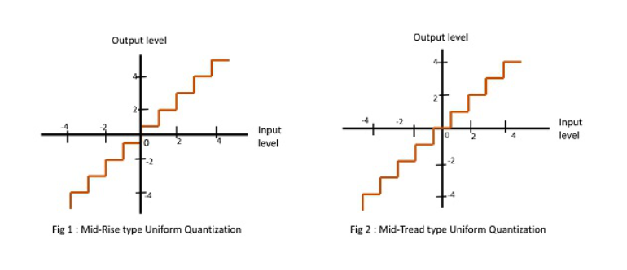
Types of uniform quantization

Slide 17
The Mid-Rise type is so called because the origin lies in the middle of a raising part of the stair-case like graph.
The Mid-tread type is so called because the origin lies in the middle of a tread of the stair-case like graph.
Both the mid-rise and mid-tread type of uniform quantizers are symmetric about the origin.

Slide 18
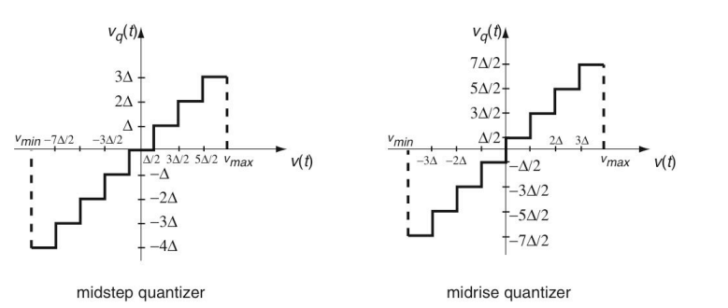
MID TREAD MID RISE

Slide 19
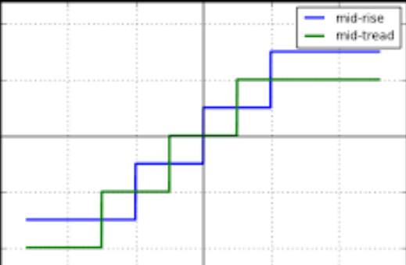

Slide 20
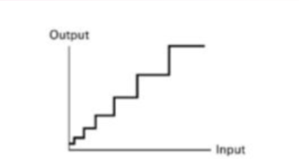
Non-uniform Quantization
The type of quantization in which the quantization levels are unequal and mostly the relation between them is logarithmic.
Smaller amplitude s/gs are represented by smaller step size
Larger amplitude s/gs are represented by larger step size

Slide 21
Non uniform quantizers are difficult to make & are expensive.
Alternative is to use a compressor followed by uniform quantizer.
Compressor produces non linearity to s/g before passing to uniform quantizer. ie, s/g amp will be compressed and passed to uniform quantizer.
At receiver side the s/g is expanded by an inverse to the non linearity.
Process of compressing at Txr and expanding at Rxr is known as companding.

Slide 22
Companding
The word Companding is a combination of Compressing and Expanding.
This is a non-linear technique used in PCM which compresses the data at the transmitter and expands the same data at the receiver.
Companding is a technique of achieving non-uniform quantization.
It is done in order to improve SNR of weak signals.
The effects of noise and crosstalk are reduced by using this technique.

Slide 23
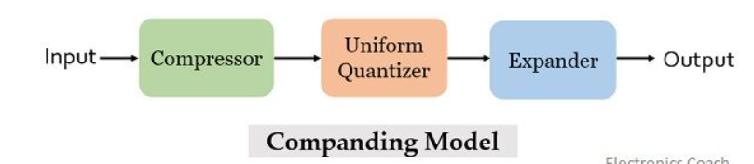
Initially at the transmitting end, the signal is first provided to the compressor.
The compressor unit amplifies the weak signal in order to increase the signal level of the applied input signal.
If the input signal is a high level signal or strong signal, then compressor attenuates that signal before providing it to the uniform quantizer present in the model.
This is done in order to have an appropriate signal level as the input to the uniform quantizer.

Slide 24
Weak s/gs are artificially boosted to improve the s/g to quantization noise noise ratio.
The output of the compressor is provided to uniform quantizer where the quantization of the applied signal is performed.
At the receiver end, the output of the uniform quantizer is fed to the expander.
It performs the reverse of the process executed by the compressor.
This is done in order to achieve the originally transmitted signal at the output.

Slide 25
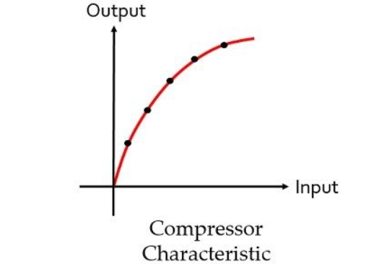
Characteristics of Compander
Compressor characteristic: The figure below shows the graphical representation of characteristic of the compressor:
The graph clearly represents that the compressor provides high gain to weak signal and low gain to high input signal.

Slide 26
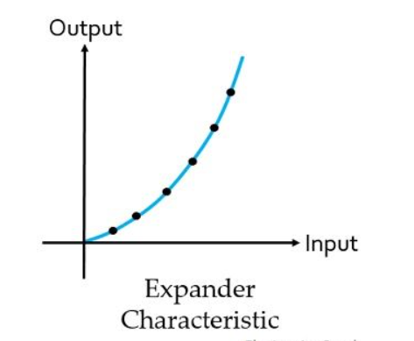
Expander characteristic: Here the figure shows the characteristic of expander:
Expander performs reverse operation of the compressor. So, it is clear from the above figure that artificially boosted signals is attenuated to have the originally transmitted signal.

Slide 27
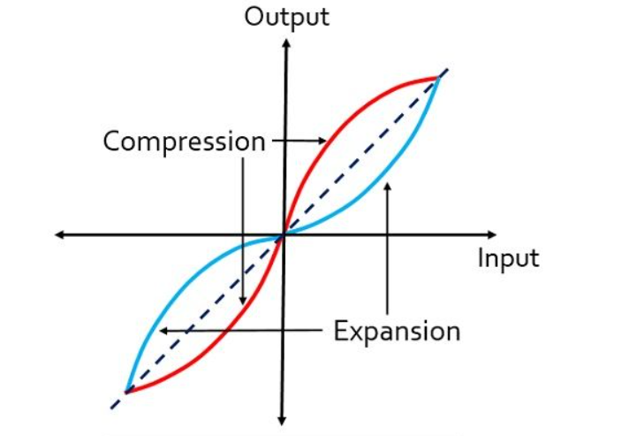
COMPANDING CURVE FOR PCM S/M

Slide 28
The compressor and expander performs inverse operations thus in the above figure the dotted line represents the linear characteristic of the compander indicating that the originally transmitted signal is recovered at the receiver.
2 types of Companding techniques
µ-law Companding Technique
A-law Companding Technique

Slide 29
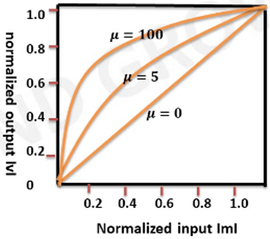
µ-law Companding Technique
In this, compressor characteristic is continuous.
It is described as |v| = $\frac{log(1+µ\left|m\right|)}{log(1+µ)}$
µ is a constant.
m & v are normalised i/p & o/p voltages.
For convenience of presentation, the input to the quantizer and its output are both normalized so as to occupy a dimensionless range of values from zero to one, as shown in Fig.

Slide 30
Uniform quantization is achieved at µ = 0, where the characteristic curve is linear and no compression is done.
µ-law has mid-tread at the origin. Hence, it contains a zero value.
µ-law companding is used for speech and music signals.
Used in Japan & America

Slide 31
For a given value of µ, the reciprocal slope of the compression curve, which defines the quantum steps, is given by
$$\frac{d|m|}{d|v|}= \frac{\log\left(1+µ\right)}{µ}(1+µ\left|m\right|)$$
So µ law is neither strictly linear nor strictly logarithmic.
But it is approx. linear at low i/p levels corresponding to $µ\left|m\right|$ <<1 & approximately logarithmic at high i/p levels corresponding to $µ\left|m\right|$ >>1.

Slide 32
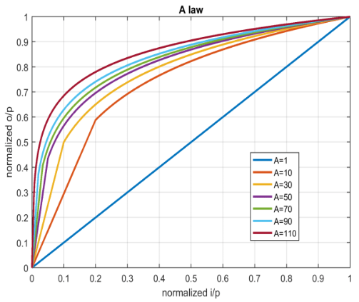
A-law Companding Technique
In this compressor chara is piecewise, made up of a linear segment for low level i/ps and a logarithmic segment for high level i/ps.
It is described as
|v| = $\left\{\begin{aligned}\frac{A|m|}{1+\log{A}} , for 0≤\left|m\right|≤\frac{1}{A} \\ \frac{1+log⁡(A\left|m\right|)}{1+\log{A}} , for \frac{1}{A} ≤\left|m\right|≤1\end{aligned}\right\}$

Slide 33
Uniform quantization is achieved at A = 1, where the characteristic curve is linear and no compression is done.
A-law has mid-rise at the origin. Hence, it contains a non-zero value.
A-law companding is used for PCM telephone systems.
Used in India & European countries.

Slide 34
The reciprocal slope of this compression curve is
$\frac{d|m|}{d|v|}=$ $\left\{\begin{aligned}\frac{1+\log{A}}{A} , for 0≤\left|m\right|≤\frac{1}{A} \\ (1+log A)\left|m\right|, for \frac{1}{A} ≤\left|m\right|≤1\end{aligned}\right\}$

Slide 35
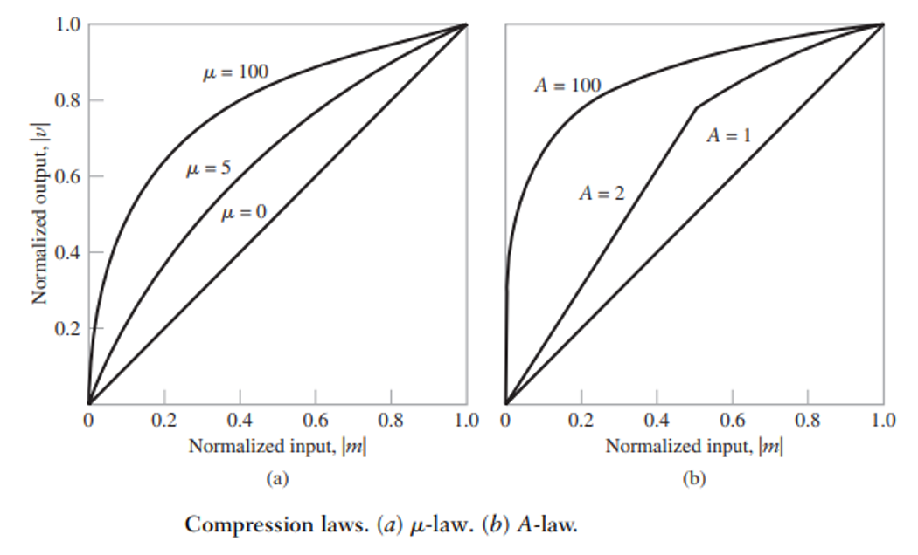

Slide 36
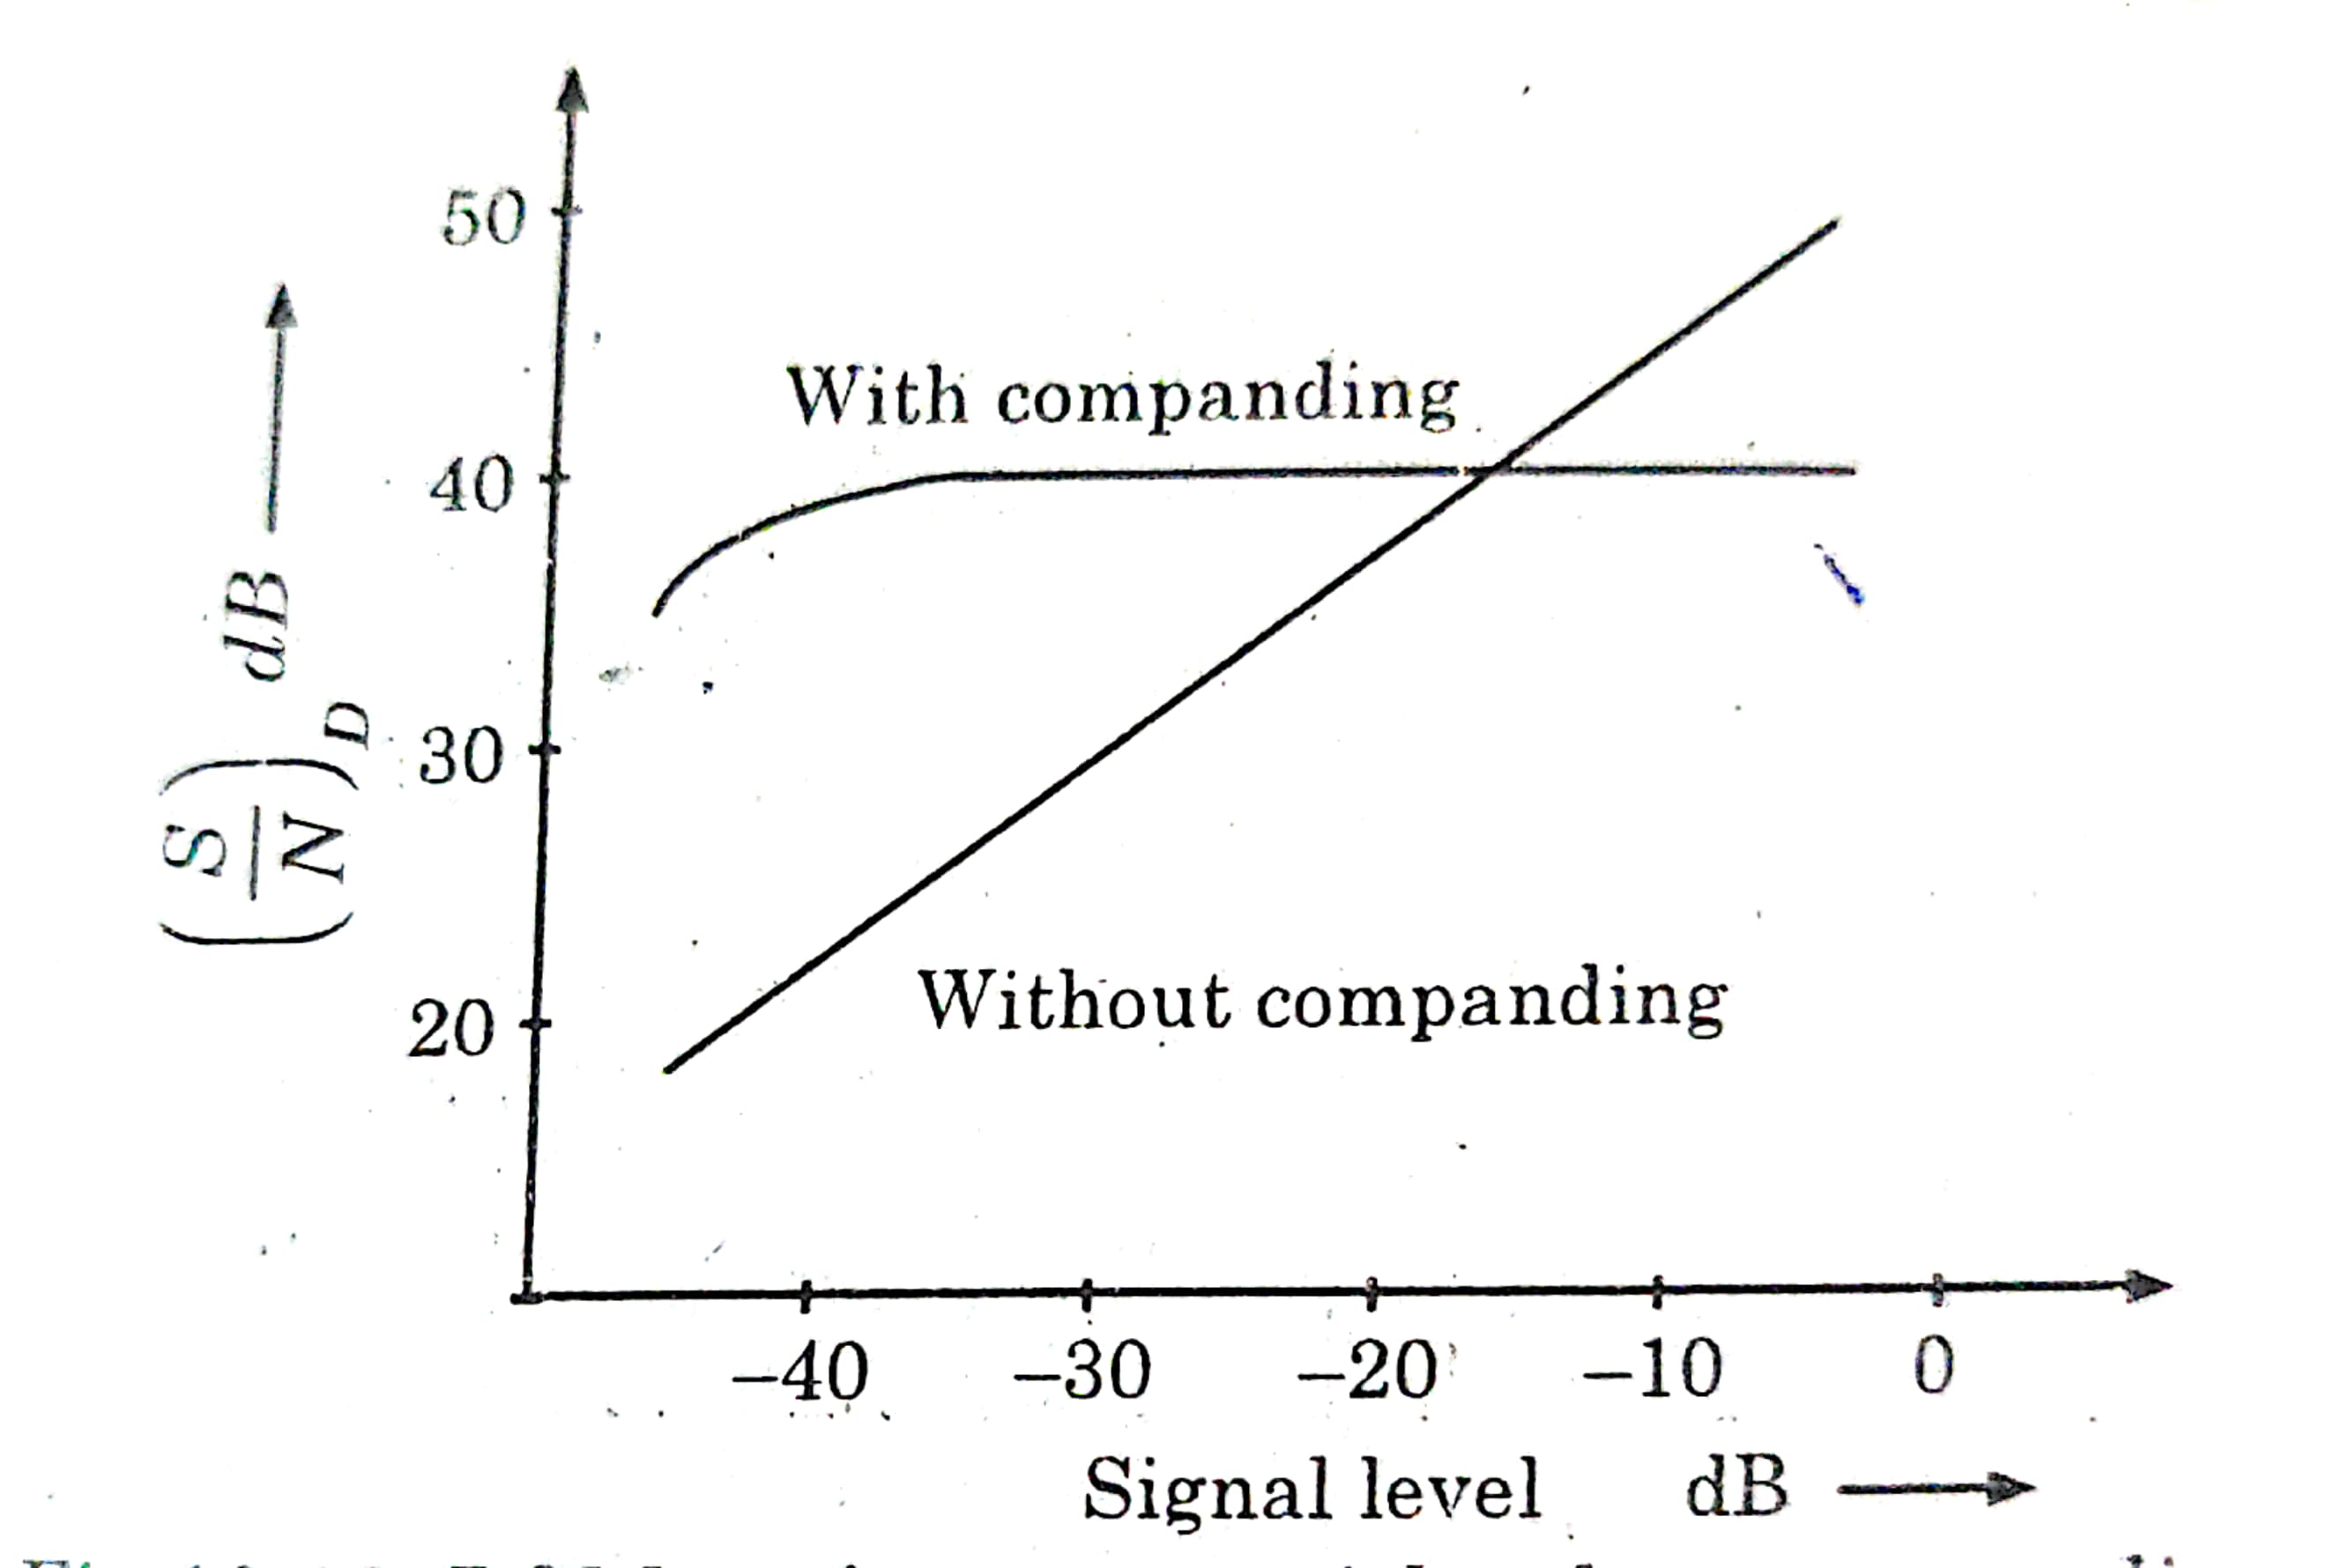
Fig: PCM performance with µ-law companding . Figure shows the variation of SNR wrto s/g level w/o companding & with companding. It can be seen that SNR of PCM remains almost constant with companding.

Slide 37
